Slide 1
Pairing Up with Pear Deck
Emily Veraa, M.Ed - Leander High School

Slide 2
Draw or type 2 things you already know about Pear Deck:
Notes:
Access Prior Knowledge
Use the template to prompt students to access prior knowledge on today’s topic. You can change the wording to fit your lesson.
🍐 This is a Pear Deck Drawing Slide
🍐 To edit the type of question, go back to the "Ask Students a Question" in the Pear Deck sidebar.

Slide 3
Welcome to Pear Deck!
Pear Deck allows you to turn your presentations into interactive lessons for your classroom.
You can receive real time feedback from your students about their learning and understanding.
Students are engaged with their learning and can communicate with you about their mastery of the topic.

Slide 4
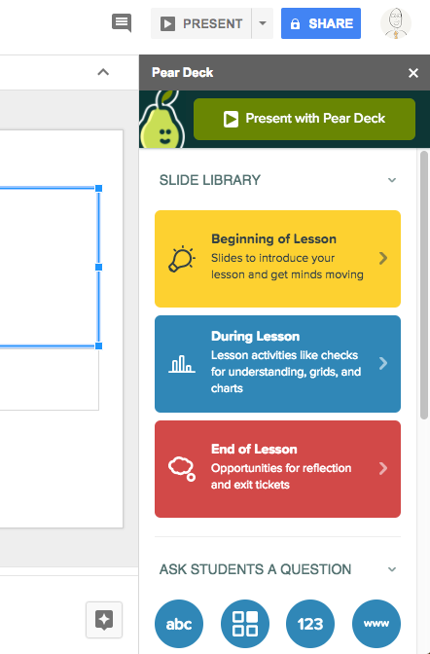
Let’s Get Started!
Step 1 Open a Google Slides presentation
Step 2 Click on the “Add-ons” menu and “get add-ons…”
Step 3 Search for “Pear Deck” and click the blue “+FREE” button
Step 4 Load up the Pear Deck sidebar menu. It will look like the image to the right
You can also use this video link to assist you

Slide 5
Using Microsoft Powerpoint
Step 1 Install the Pear Deck add-in to Powerpoint
Step 2 You will get a sidebar that lets you add interactive questions and pre-made templates
Step 3 You can also add Pear Deck to Microsoft Teams
Step 4 Design a new lesson or open an existing presentation from One Drive.
Use this link to help you create Pear Deck with PowerPoint

Slide 6
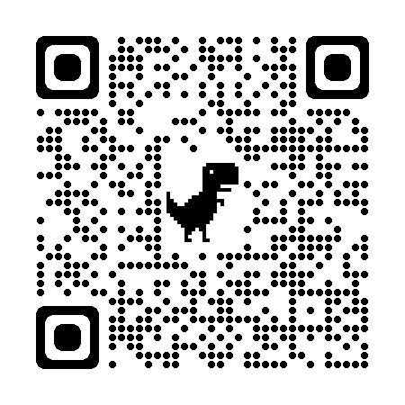
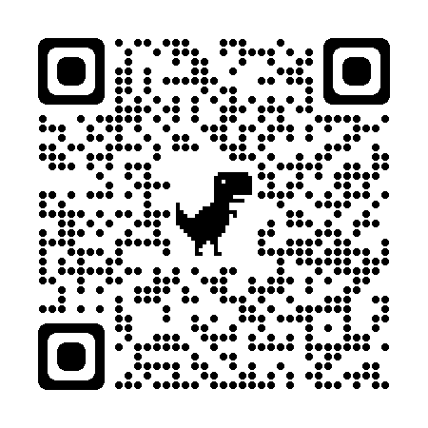
QR COdes for Set Up Help
Google Slides
Power Point

Slide 7
I can only use Pear Deck with Google Slides
True
False
Notes:
True or False
Use this template to do a quick check of students’ perceptions during your lesson.
🍐 This is a Pear Deck Multiple Choice Slide. Your current options are: A: True, B: False,
🍐 To edit the type of question or choices, go back to the "Ask Students a Question" in the Pear Deck sidebar.

Slide 8
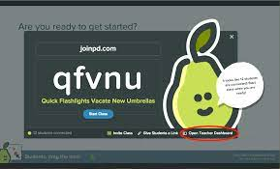
Start a Lesson

Slide 9
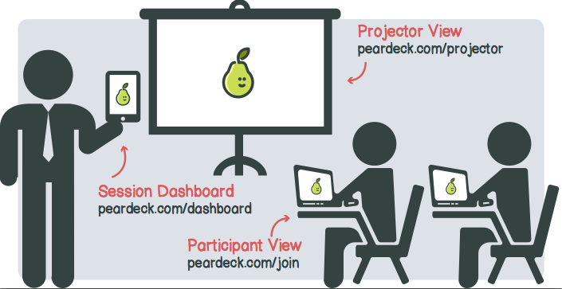

Slide 11
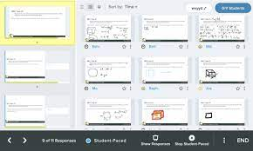
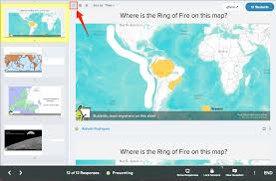
Where do you go to view student work?
Notes:
🍐 This is a Pear Deck Multiple Choice Slide. Your current options are: A: Teacher Dashboard, B: Student View, C: Projector View,
🍐 To edit the type of question or choices, go back to the "Ask Students a Question" in the Pear Deck sidebar.

Slide 12
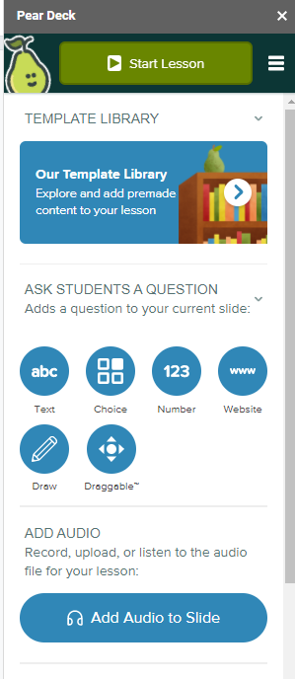
Interactive Slide Options
Enter text
Enter a number
Choose from multiple choices
Draw a response (premium only)
Interact with a live web page
Drag an icon to a specific part of the slide (premium only)

Slide 13
Draw lines to match the image to the answer:
Bull
Immature Female
Bovine
Castrated Male
Heifer
Mature Male
Cow
Mature Female
Steer
Baby Cattle
Calf
Term for Cattle
Notes:
Matching
This is an example of a matching activity. Change the terms to fit your own content.
🍐 This is a Pear Deck Drawing Slide
🍐 To edit the type of question, go back to the "Ask Students a Question" in the Pear Deck sidebar.

Slide 14
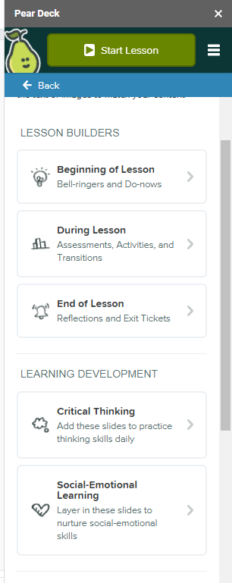
Pear Deck Slide Library
For the beginning of a lesson (check prior knowledge, ask what students are curious about)
During the lesson (summarize, assess learning, gauge understanding)
At the end of the lesson (retell what they learned, share feelings)

Slide 15
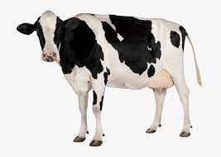
Use the word bank to label the diagram:
Word Bank
Dewclaw
Brisket
Tail
Poll
Pins
Notes:
Label the Diagram
This is an example of a labeling activity. Swap the bee image out for your own illustration, diagram, or map. You can use the Word Bank to prompt students with the labels they need to use.
🍐 This is a Pear Deck Drawing Slide
🍐 To edit the type of question, go back to the "Ask Students a Question" in the Pear Deck sidebar.

Slide 16
Drag your dot to how you are feeling:
Keep going, I understand
I’m a little confused
Stop, I need help!
Notes:
Temperature Check
WIth this slide, you can get a quick idea of how your students are feeling about the pace of the lesson. Getting consensus before moving on helps ensure everyone is still with you, and identify the students who might need extra attention.
🍐 This is a Pear Deck Draggable™ Slide.
🍐 To edit the type of question, go back to the "Ask Students a Question" in the Pear Deck sidebar.

Slide 17
Next Steps
Set up the Slide Deck the way you want
Create presentations using presentations you have already created and add interactive slides
You can create new presentations with interactive slides
Engage with students in the classroom

Slide 18
Reflect on today’s activities:
What did you like? | What didn’t you like?
What was easy? | What was hard?
Notes:
Reflection
Use this template to gather feedback about today’s lessons and to prompt metacognitive thinking.
🍐 This is a Pear Deck Drawing Slide
🍐 To edit the type of question, go back to the "Ask Students a Question" in the Pear Deck sidebar.

Slide 19
Thank you for joining me today
Questions? Feel Free to contact me
Email: Emily.Veraa@leanderisd.org
Instagram: @MrsVeraasClass
Twitter: @MrsVeraasClass

